Slide 1

Knowledge Graphs and Industry 4.0
-ESHA CHAUGULE
C No. C22018441668
Roll No. 3610
Information Technology
Cummins College of Engineering, Pune

Slide 2
Key Concepts
Problem Statement
Industry 4.0
Interoperability
Smart Factories
CPS
IIOT
AI
Ability to share information between systems in meaningful ways
Data Integration
Taking data from many disparate sources and making it usable
Knowledge Graphs
Storing data in the form of associations

Slide 3
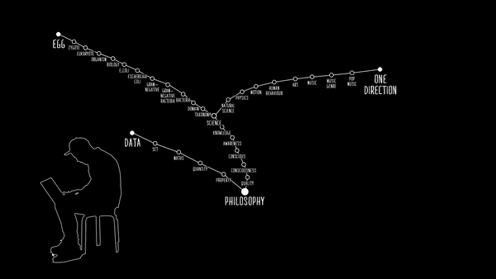
Connecting Data with Knowledge Graphs[1]

Slide 4
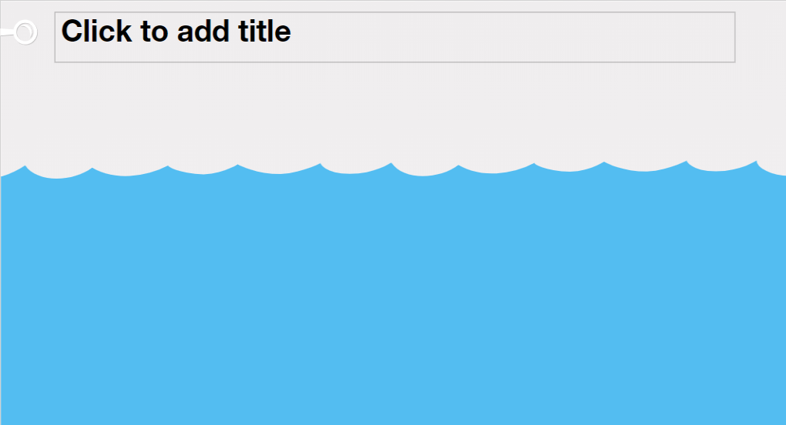
HOW DO KNOWLEDGE GRAPHS HELP IN SOLVING INTEROPERABILITY CONFLICTS
The fourth industrial revolution, Industry 4.0 (I40) aims at creating smart factories CPS, IoT and AI.
Different standards may contain divergent definitions for similar entities.
For establishing interoperability, industry communities have created standards and standardization frameworks.
Smart factories I40 vision: intelligent human-to-machine, machine-to-machine communication.
INTEROPERABILITY CONFLICTS
FIRST LEVEL OF CHALLENGES
METHODOLOGY FOR CREATING I40KG
STO ONTOLOGY
[2]https://www.researchgate.net/publication/333532727_A_Knowledge_Graph_Based_Integration_Approach_for_Industry_40

Slide 5

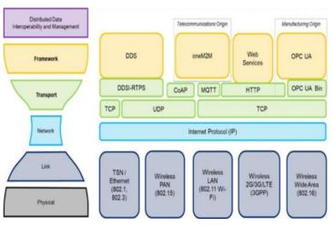
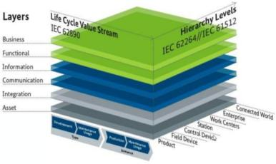
OPC UA
OPC UA, MQTT
MQTT
INTEROPERABILITY CONFLICTS
RAMI4.0 IT layer
IICF Model
Reference Architectural Model for I40
Industrial Internet Connectivity Framework
Both, OPC UA and MQTT positioned at communication level, stating that both standards are similar.
OPC UA and MQTT at distinct layers, i.e., the framework and the transport layers, respectively
[3]https://link.springer.com/chapter/10.1007%2F978-3-030-59051-2_12

Slide 6

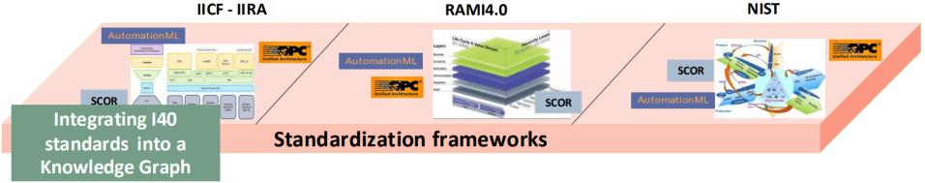
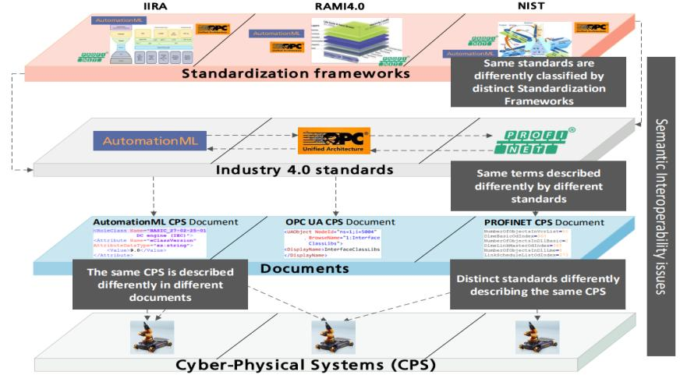
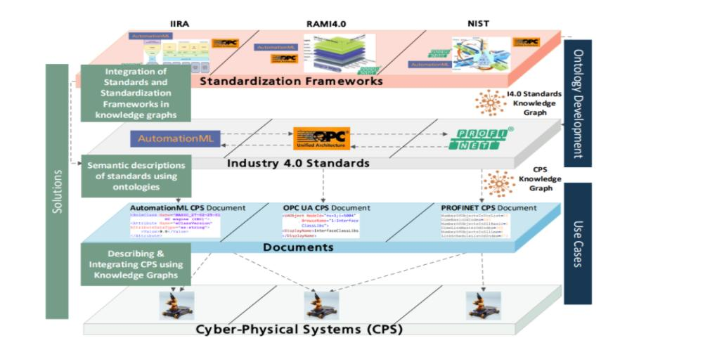
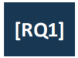
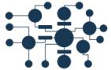

FIRST LEVEL OF CHALLENGES[2]
I40 Standards Knowledge Graphs

Slide 7
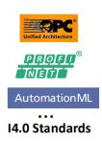
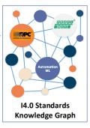

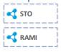
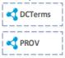
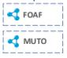

INPUT
METHODOLOGY FOR CREATING I40KG[2]
Document selection
Mapping to standardization frameworks
Knowledge Graph Population
Knowledge Integration
Knowledge Graph Reasoning
Knowledge Graph Interlinking
In-house Vocabularies
Linked Open Data Vocabularies
OUTPUT
I4.0 Standard Documents
Generic Ontology?
STO
Legend
Manual
Semi-automatic

Slide 8
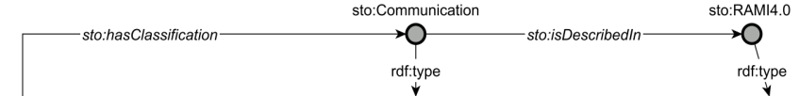
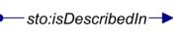
THE STANDARDS ONTOLOGY[2]
sto:Standard
sto:StandardClassification
sto:StandardizationFramework

Slide 9

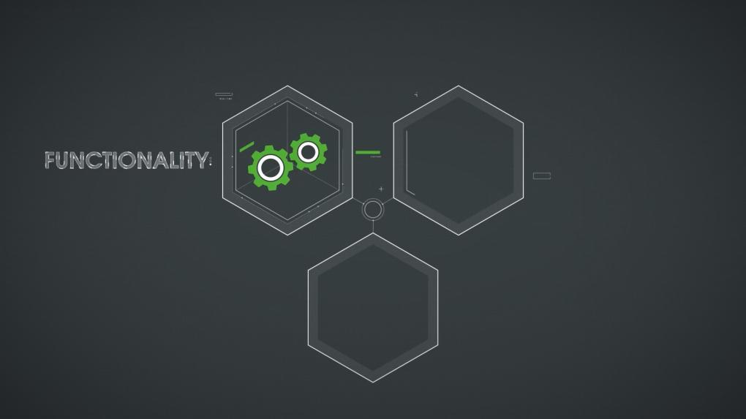
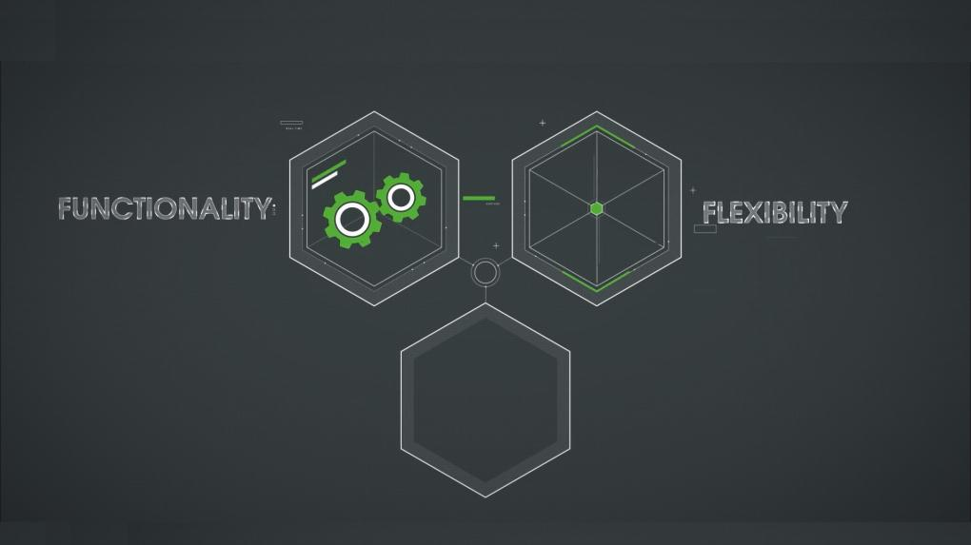
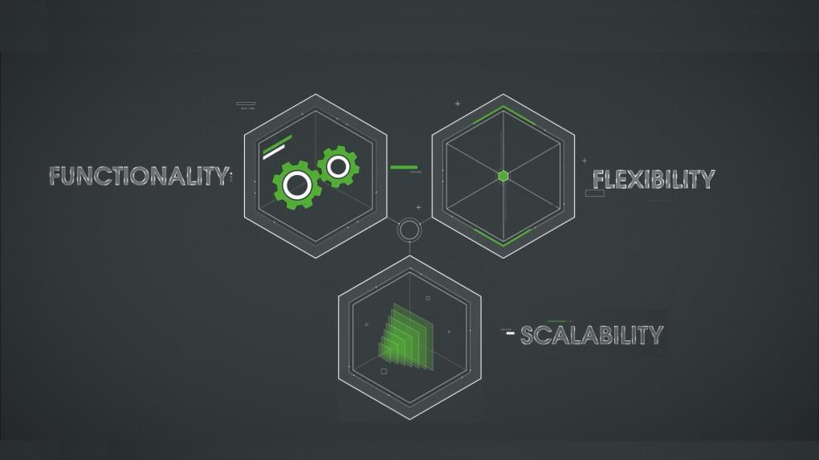
PTC ThingWorx
PTC ThingWorx
PTC ThingWorx
PTC ThingWorx
[4]https://www.ptc.com/en/products/thingworx

Slide 10

INTEGRATING INDUSTRY 4.0 IMPLEMENTATION
DECISION LABEL:
direct operation grouping and behavior decision of equipment operation and maintenance
MODEL LABEL:
marking after secondary processing based on the grid equipment analysis model, equipment status
FACT LABEL: categorization based on raw data cleanup, alarm times, failures times, power outages times
RAW DATA: equipment ledger, measurement data, maintenance data, event data and operation data obtained through the data center
[5]https://www.hindawi.com/journals/mpe/2020/8269082/

Slide 11


